Slide 1
Introduction to Next Generation Sequencing
9 Oktober 2019
Wouter Bossuyt
Genomics Core Leuven

Slide 2
Program

Slide 3
Program

Slide 4
Next Genomics Core Seminars
RNAseq: from experiment to insight
8th November
High Performance computing for Genomics
6th December
Everything you ever wanted to know about single cell genomics
January, TBD

Slide 5
What’s the use of technology if it is not usable?

Slide 6
Mission
Make the NGS revolution a possibility for everyone
Introduce novel technologies as service
Reduce cost by optimizing sequencing
Diagnose patients
Diagnostics
±1500 projects/year
Research
±550 projects/year

Slide 7
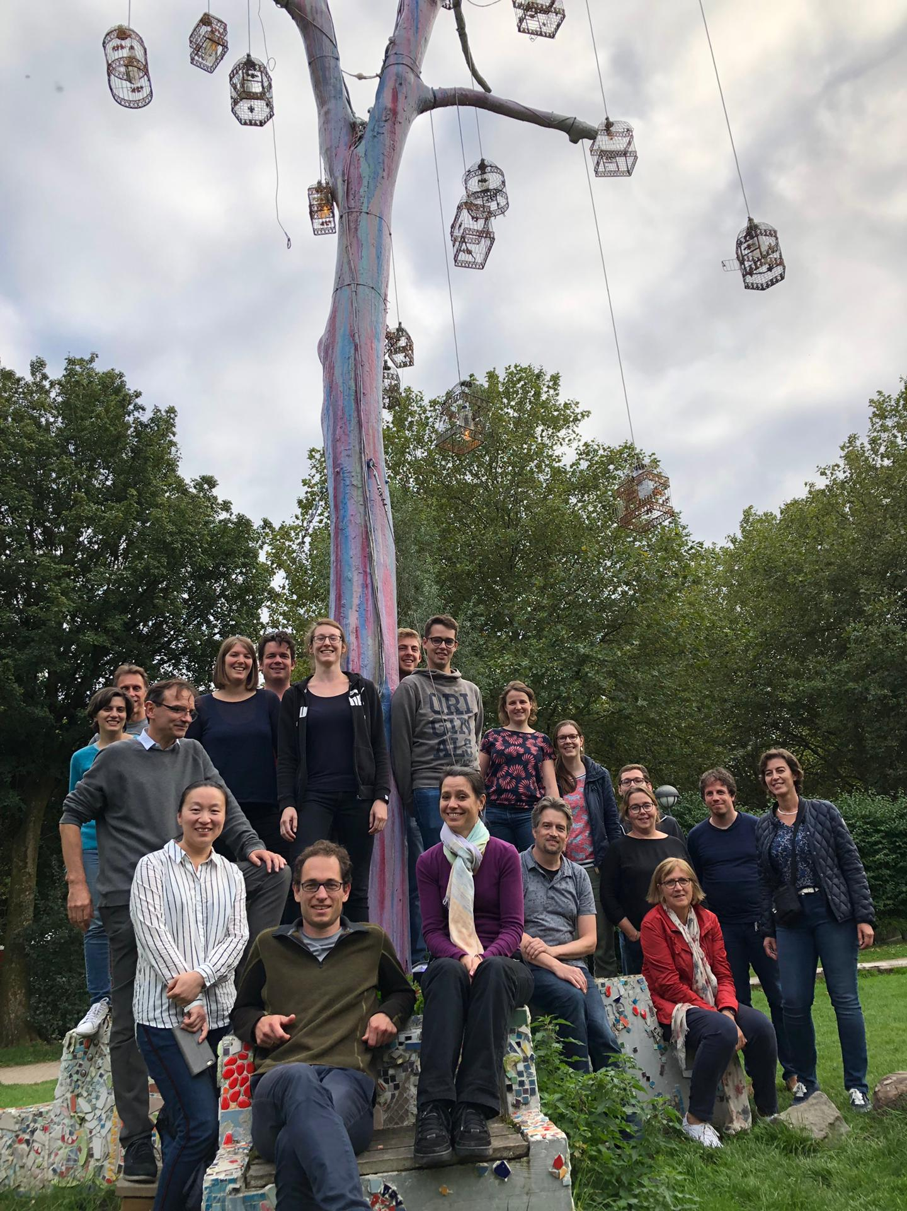
Who are we?
8 wet lab people
9 bio-informaticians
4 supporting people

Slide 8
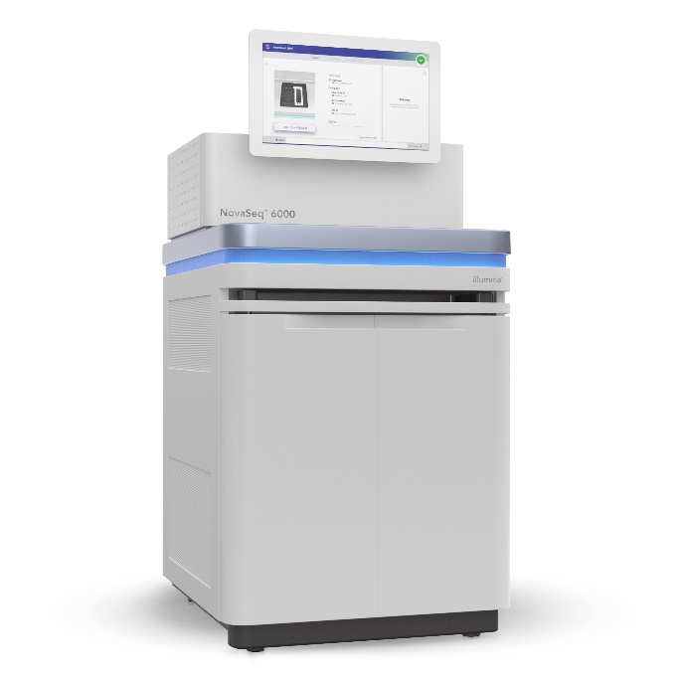
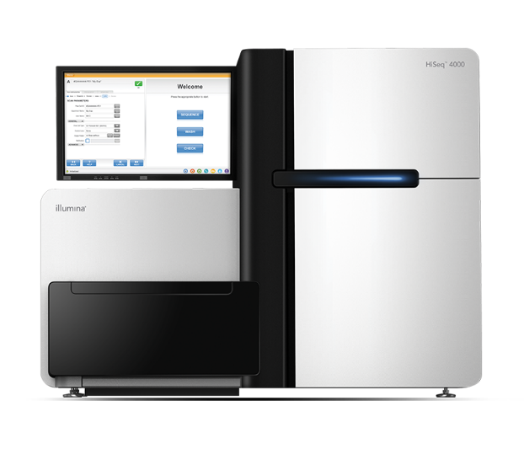
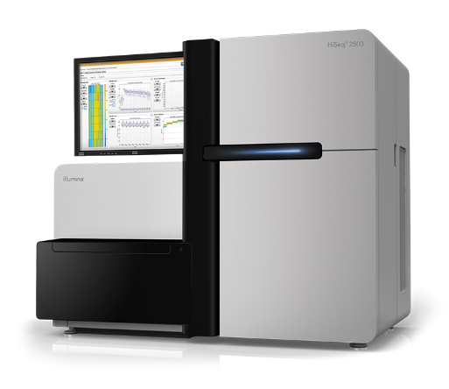
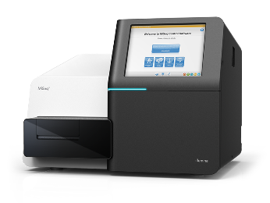
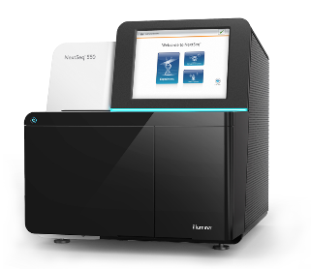
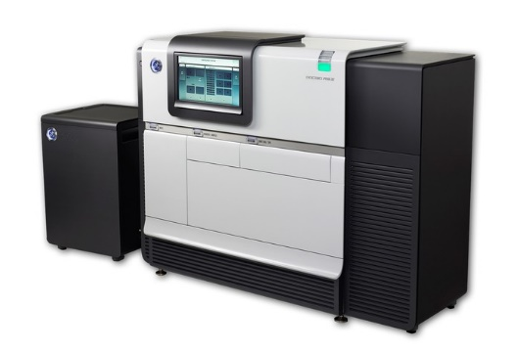
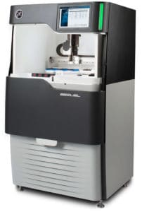
Sequencing
Illumina
Miseq
Nextseq
Hiseq 2500
Hiseq 4000
Novaseq
PacBio
Pacbio RSii
Pacbio Sequel

Slide 9
DNA
RNA
Single cell genomics
Amplicon
MIPs
de novo assembly
Bacterial WGS
Vertebrate WGS
Long read sequencing
Truseq stranded mRNA
Lexogen quantseq
IsoSeq (Pacbio)
DepArray
SMART-seq2
10x Genomics
Sequencing only

Slide 10





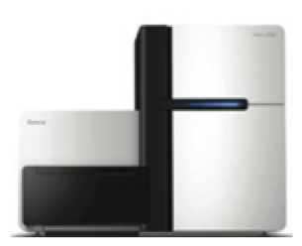

How to get started?
8-10 weeks
request
Library prep and sequencing

Slide 11
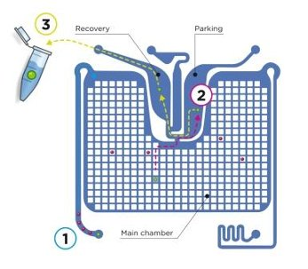
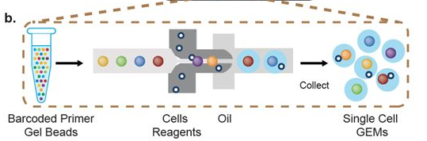
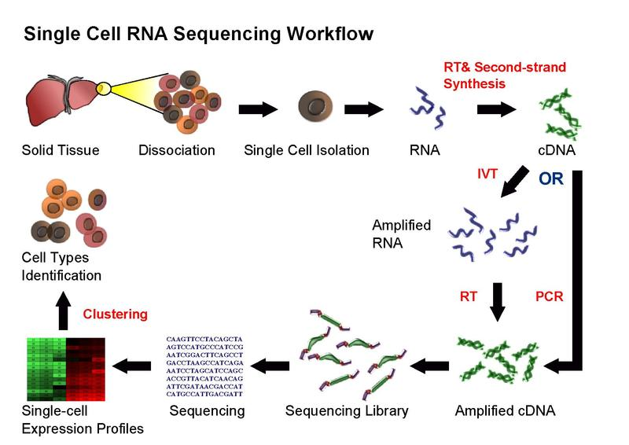
Single cell Core
Sort cells with DepArray
Sort cells and do library prep with 10x Genomics
SmartSeq for single cell transcriptomics

Slide 12
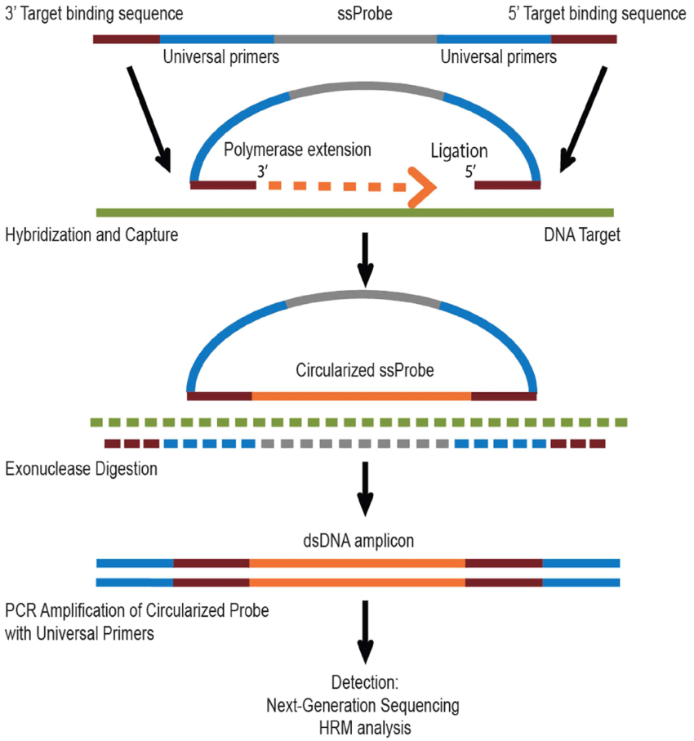
Design your own assay
I have a lot of samples in which I want to investigate certain genes
We design your MIP-assay
Design
Optimization
Library prep
sequencing

Slide 13

Speed program for fast sequencing
Your data back below 4 weeks
No extra cost
For sequencing-ready libraries taking up an entire run/lane*
Miseq run
Hiseq 2500 PE125 run
Hiseq 4000 SR50 lane
Novaseq run
No library QC from our end!

Slide 14
Data Analysis: What we offer
Always demultiplexed (separate files for separate samples), and mapped for species with references genome
Differential expression analysis included in price of RNAseq library prep
Custom project possible
NEW: Cloud-enabling services

Slide 15
Conclusion
We can do all or just part of the sequencing
Fast is possible for sequencing only
If you want to do sequencing: talk to us!

